Slide 1


HTML Basics
Hypertext Markup Language
SoftUni Team
Technical Trainers
Software University
http://softuni.bg

Slide 2
Table of Contents
What is HTML?
Element anatomy
Document anatomy
Formatting text
Attributes
Images, Links and Forms
Nested and empty elements

Slide 3
Questions?
sli.do
#TECH-FUND

Slide 4

HTML
Standard for Markup Language

Slide 5

What is HTML?
HTML (Hypertext Markup Language) is the code used to build and display a web page and its content.
HTML is the standard markup language for creating web pages and web applications.
It represents a series of elements that you use to surround (or wrap) different portions of content to make them look and act in a certain way.

Slide 6

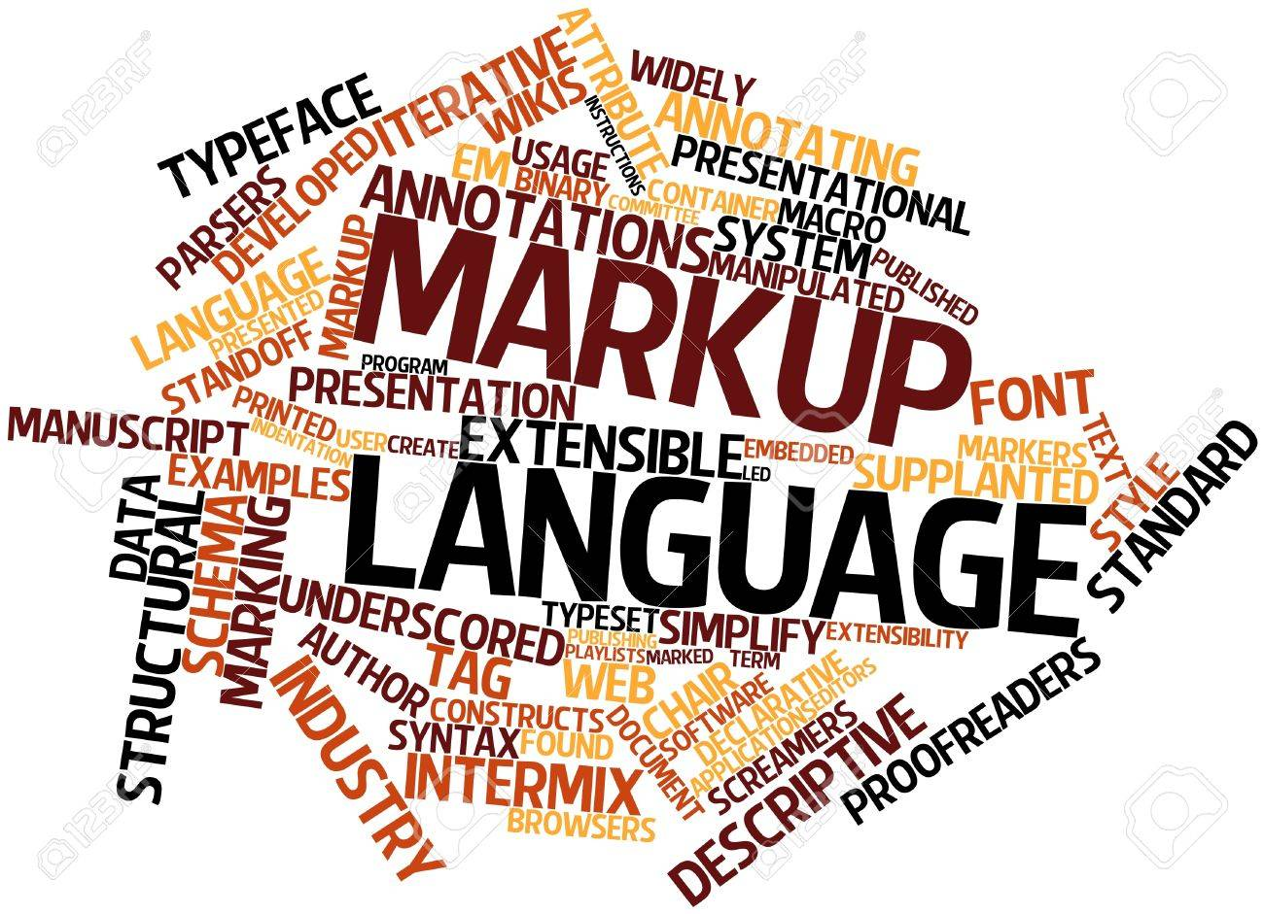
What is HTML?
HTML is not a programming language - it is a markup language that is used to tell your browser how to display the pages you are visiting.
It’s just a text file with .html extension.

Slide 7
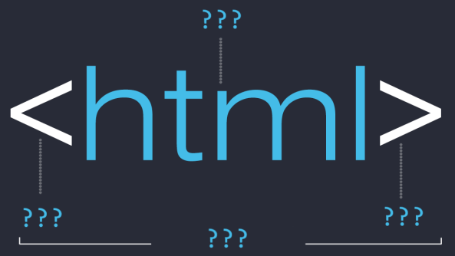
Anatomy of an element

Slide 8
Element anatomy
The main parts of an element are:
Opening tag, Content and Closing
Opening tag - It consists of the name of the element surrounded by opening and closing angles. This indicates where the element starts.
Character (Tag name)
Left angle bracket (Less than sign)
Right angle bracket (Greater-than sign)
<html>

Slide 9
Element anatomy
Closing tag - Same as the opening tag, but with an additional slash before the item's name. This shows where the element ends.
Character (Tag name)
Left angle bracket (Less than sign)
Right angle bracket (Greater-than sign)
</html>
Forward slash (end tag indicator)

Slide 10
Element anatomy
Everything between the opening and closing tags is defined as the content of this element.
The content of this element is visualized in one form or another.
The element is the set of the opening tag, closing tag, and content.
<html> <!-- HTML ELEMENT CONTENT--> </html>

Slide 11
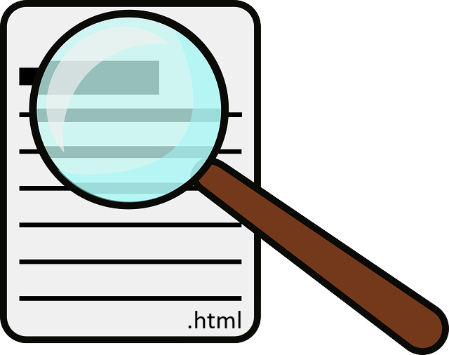
Document anatomy

Slide 12
Document anatomy
This covers the basics of individual HTML elements, but they do not have a particular benefit when used individually.
<!DOCTYPE html> <html lang="en"> <head> <meta charset="UTF-8"> <title>HTML</title> </head> <body>…</body> </html>
Тhis is the basic requirement for content that a html file should have!

Slide 13
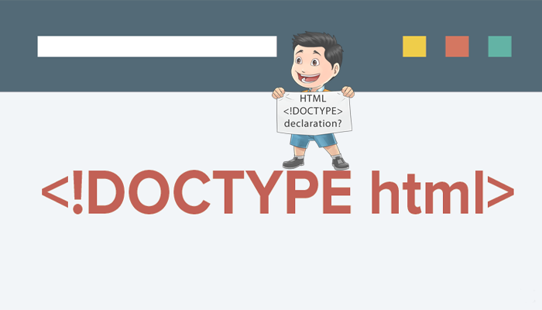
Document anatomy
<!DOCTYPE html> - Describes the HTML that will be used in your page. It is not an HTML tag! It is an instruction to the web browser about what version of HTML the page is written in.
The doctype is supported by all web browsers like:
Chrome, Firefox, IE, Safari and Opera

Slide 14
Document anatomy
<html> tag - This element surrounds the entire content of the page and is usually called the basic element.
The html element must contain a head element followed by a body element.
<!DOCTYPE html> <html> <head> … </head> <body> … </body> </html>
HTML ELEMENT CONTENT

Slide 15

Document anatomy
<head> tag - It acts as a container for all the things that you include on the page but are not part of the content you show to visitors to your page.
Information about the document - is placed. It should be the first element inside an html element.
<!DOCTYPE html> <html> <head> <!-- HEAD ELEMENT CONTENT--> </head> <body> …
</body> </html>
<head>
meta
links
script
title

Slide 16
Document anatomy
Head is required and it should be used just once. It should start immediately after the opening html tag and end before the opening body tag.
<body> tag defines the main content of the HTML document or the section of the HTML document that will be directly visible on your web page.
<!DOCTYPE html> <html> <head> … </head> <body> <!-- BODY ELEMENT CONTENT--> </body> </html>

Slide 17

Document anatomy
This tag is also commonly referred to as the <body> element.
It contains everything you want to show visitors to your page like text, images, video clips, games, audio.

Slide 18
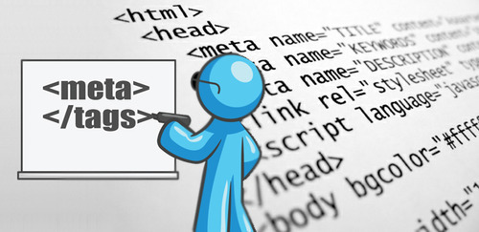
Document anatomy
<meta> tag (meta information) is information about the information. The <meta> tag provides information about the HTML document.
The information inside the item is not displayed on the page but is relied on by the machine.

Slide 19
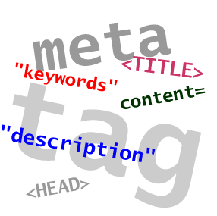
Document anatomy
The metadata is used by the browser to know how to load the page or reload it, from the search engines (keywords) or other web services.
<meta> tags are always in the <head> element.
Meta elements are usually used to add a description to the page, keywords or character sets.

Slide 20
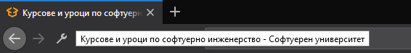
Document anatomy
Tag <title> defines the title of the document. It is required in any HTML document, but if it is not present in HTML5, the document remains completely valid. The following apply to the <title> element:
Defines the title in the browser's toolbar
Gives a page title when added to favorites
Shows the title of the page in the search engines
Title

Slide 21

Formatting text

Slide 22
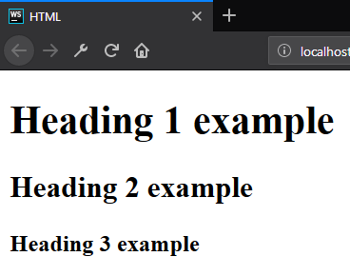
Formatting text - Heading
Heading - Allow you to specify that certain portions of the content are titles or subheadings.
<body> <h1>Heading 1 example</h1> <h2>Heading 2 example</h2> <h3>Heading 3 example</h3> </body>

Slide 23
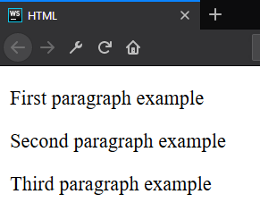
Formatting text - Paragraph
Paragraphs - Are meant to contain the individual paragraphs in the text.
<body> <p>First paragraph example</p> <p>Second paragraph example</p> <p>Third paragraph example</p> </body>

Slide 24
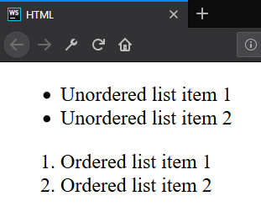
Formatting text - List
Lists - The lists contain at least two elements. The most common types are ordered and unordered lists.
<ul> <li>Unordered list item 1</li> <li>Unordered list item 2</li> </ul> <ol> <li>Ordered list item 1</li> <li>Ordered list item 2</li> </ol>

Slide 25
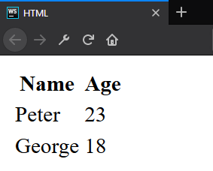
Formatting text - Table
Table - Is a structured set of data made up of rows and columns.
<table> <thead> <tr><th>Name</th><th>Age</th></tr> </thead> <tbody> <tr><td>Peter</td><td>23</td></tr> <tr><td>George</td><td>18</td></tr> </tbody> </table>

Slide 26
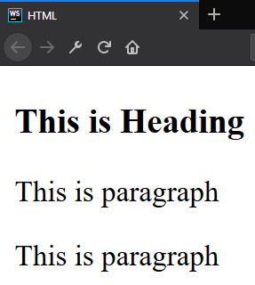
Formatting text – Division element
Division element (div) is the generic container for flow content. It has no effect on the content or layout.
As a "pure" container, the <div> element does not inherently represent anything.
<div> <h3>This is Heading</h3> <p>This is paragraph</p> <p>This is paragraph</p> </div>

Slide 27
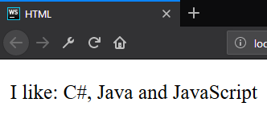
Formatting text - Span
Span element is a generic inline container for phrasing content, which does not inherently represent anything. It can be used to group elements for styling purposes.
<p> I like: <span>C#, Java and JavaScript</span> </p>

Slide 28
id?
class?
style?
name?
Attributes

Slide 29
Attributes
An attribute is a characteristic (special words) used inside the opening tag to control the tag's behavior.
In HTML, an attribute is a characteristic of a page element, such as font size or color.
Must have space
No space allowed
No space allowed
<p id="myId"></p>
Attribute
name
Attribute
value

Slide 30
Attributes
Attributes are used to amplify a tag. When a Web browser interprets an HTML tag, it will also look for its attributes so that it can display the Web page's elements properly.
Generally appear as name-value pairs, separated by '='.
<div class="divElement" id="mainContainer" In this case, the attributes will not affect the content of the div. </div>
Full list of all HTML attributes: Here

Slide 31



Images, Link and Forms

Slide 32

Images
<img> - Embeds an image on our page on the site where it is located. It executes it by the src (source-source) attribute, which indicates the path to the image file.
We also included the alt (alternate-substitute) attribute. Through it, we define descriptive text for users who can not see the image for some reason.

Slide 33

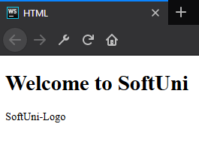
Images
<body> <h1>Welcome to SoftUni</h1> <img src="softuni-logo.png" alt="SoftUni-Logo"/> </body>
<body> <h1>Welcome to SoftUni</h1> <img src="softuniii-logo.png" alt="SoftUni-Logo"/> </body>

Slide 34
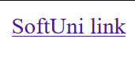
Links / References
References / links are extremely important:
They are the essence of the Web (WEB).
To add a reference, we use this simple element <a>, as it comes from anchor
It needs an attribute to hold the reference we want to make. This attribute is called href from hypertext reference.
<body> <a href="https://softuni.bg">SoftUni link</a> </body>

Slide 35
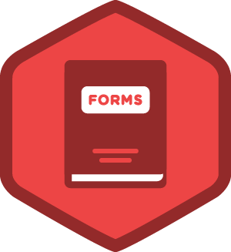
Forms
Forms are one of the main points of interaction between a user and a web site or application.
An HTML Form is made of one or more widgets. Those widgets can be text fields (single line or multiline), select boxes, buttons, checkboxes, or radio buttons.

Slide 36
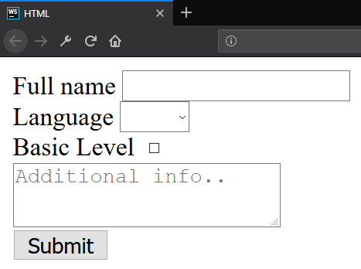
Forms
Example for a simple form:
<form>
<label for="fullName">Full name</label>
<input id="fullName" type="text" name="fullName"/><br>
<label for="language">Language</label>
<select id="language">
// TODO: Add <option> tags
</select><br>
<label for="knowledge">Basic Level</label>
<input id="knowledge" type="checkbox" name="language" value="yes"><br>
<button type="submit">Submit</button></form>

Slide 37
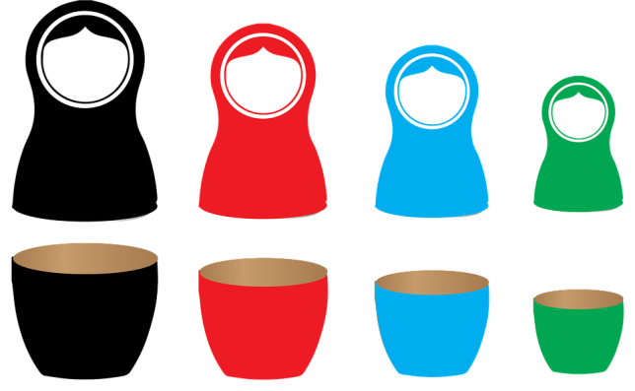
Nested and empty elements

Slide 38


Nested and empty elements
It is possible to put an element inside another element - this is called nesting.
Elements need to be opened and closed properly to be truly inside or outside of each other.
Some items have no content and are called empty elements.

Slide 39
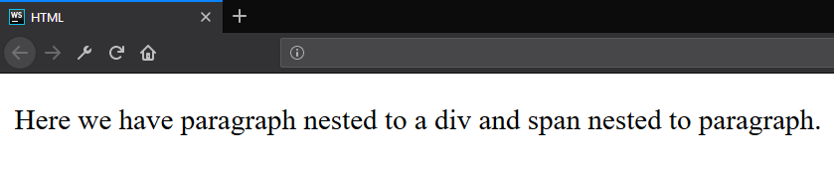
Nested elements - Example
Nested elements
<div> <p>Here we have paragraph nested to a div and <span>span nested to paragraph</span>.</p> </div>

Slide 40

Empty elements - Example
Let’s take for example <img> element.
It contains two attributes, but no closing tag </ img> and content within itself. This is because the image element does not embrace content on which to act. Its purpose is to attach a photo to the HTML page of the place it occupies.
<img src="softuni-logo.png" alt="SoftUni-Logo"/>

Slide 41

Summary
What is HTML?
Element anatomy
Document anatomy
Formatting text
Attributes
Images, Links and Forms
Nested and empty elements
…
…
…

Slide 42
https://softuni.bg/courses/technology-fundamentals

Slide 43













SoftUni Diamond Partners

Slide 44





SoftUni Organizational Partners

Slide 45




Trainings @ Software University (SoftUni)
Software University – High-Quality Education and Employment Opportunities
softuni.bg
Software University Foundation
http://softuni.foundation/
Software University @ Facebook
facebook.com/SoftwareUniversity
Software University Forums
forum.softuni.bg

Slide 46

License
This course (slides, examples, demos, videos, homework, etc.) is licensed under the "Creative Commons Attribution-NonCommercial-ShareAlike 4.0 International" license

